Slide 1
Module 1
Mgmt 6062 - Project Risk and Quality
Module 1 MGMT 6062Risk & Opportunity Management: introduction
January 4, 2024
Notes:
Notes for professor:
Update professor info slide
Provide Course at a Glance

Slide 2
Your professor
The contact information for your professor for this course can be found on FOL. The home page for this course should have contact information in the right-hand column.

Slide 3
Module agenda
Course overview
Required resources
Definition of risk
Overview of risk management
Homework

Slide 4
Course learning objectives
First half of course:
RISK Management
Develop a comprehensive risk management plan
Apply both qualitative and quantitative risk analysis
Identify risk triggers; develop and analyze the probability and impact matrix
Develop and implement various risk response strategies and contingency plans

Slide 5
Course learning objectives
Second half of course:
QUALITY Management
Create, manage and communicate a project quality plan
Apply a variety of acknowledged quality management systems and methods
Implement and control quality functions within a project while balancing the triple constraints, or other constraints such as resources.
Select appropriate project quality control using tools such as control charts, histograms, Six sigma and cause and effect diagrams.

Slide 6
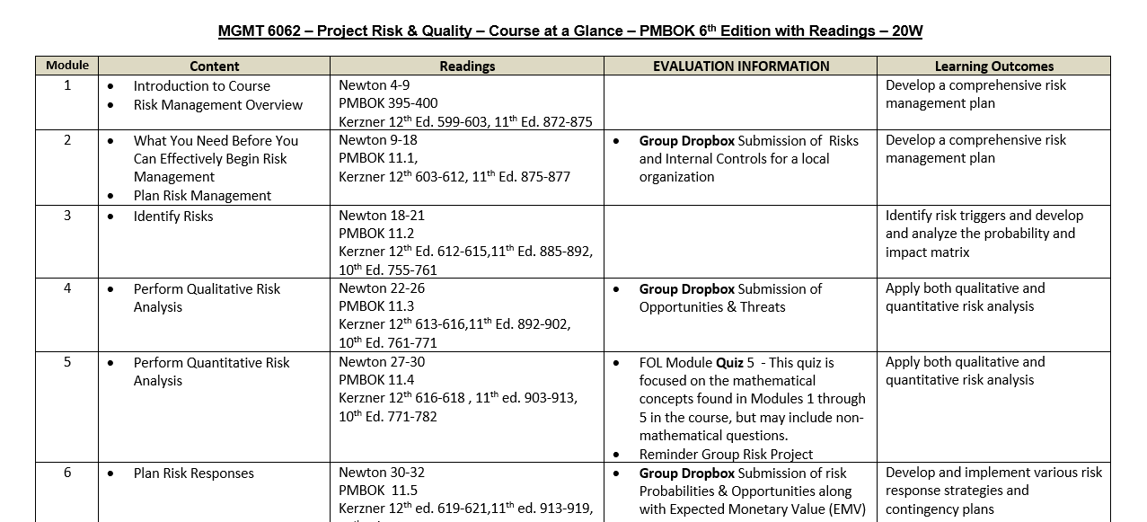
Course-at-a-glance
On FOL under Content, go to Getting Started and Resources
The course-at-a-glance includes an overview of modules, readings and evaluations -- see the version on FOL for recent updates

Slide 7
Required resources
Risk Textbook: Managing Project Risks: Project Skills https://free-management-ebooks.tradepub.com/free/w_frec48/prgm.cgi?a=1 and a few pages from Governance of Project (by Newton and Bristoll) (Sign up online – the pdf link will be sent by email)
Risk, AON Risk Solutions, 2011. http://www.aon.com/hongkong/about-aon/attachments/project-governance-risk-guide.pdf - only a few pages on Project Risk Governance will be used from this ebook
Quality Textbook: Project Quality Management: Why, What and How by Kenneth H. Rose, PMP http://www.azkhan.de/documents/Project%20Quality%20Management%20-%20Why,%20What%20And%20How.pdf

Slide 8
Required resources
Resources for this course also used in other courses:
Project Management: A Systems Approach to Planning, Scheduling and Controlling, 12th Edition Author: Harold Kerzner, PhD (or 11th Edition)
A Guide to the Project Management Body of Knowledge (PMBOK), 6th Edition Project Management Institute
Module slides (PowerPoint)

Slide 9
evaluations
FOL quizzes
Individual assignments
Group Risk Management Project
Risk Management Exam
Group Quality Management Project
Quality Management Exam
See FOL Grades for details.
You must hand in the assignments by the scheduled time. Only prearranged exceptional circumstances will be considered for extensions.
Late assignments will be graded as a zero, unless the assignment is worth 10% of the course or more, where it will be deducted 20% per day.

Slide 10
Academic offense policy
Addresses academic offences such as copying, plagiarizing, using unauthorized materials, obtaining exams prior to date.
May result in “0”, F in course, suspension or expulsion.

Slide 11
The importance of risk management
https://www.youtube.com/watch?v=G44h-TEvYy8

Slide 12
What is project risk?
An uncertain event or condition that, if it occurs, has a positive or negative effect on one or more project objectives such as scope, schedule, cost and quality.
A risk can be a threat or opportunity
A fact is not a risk

Slide 13
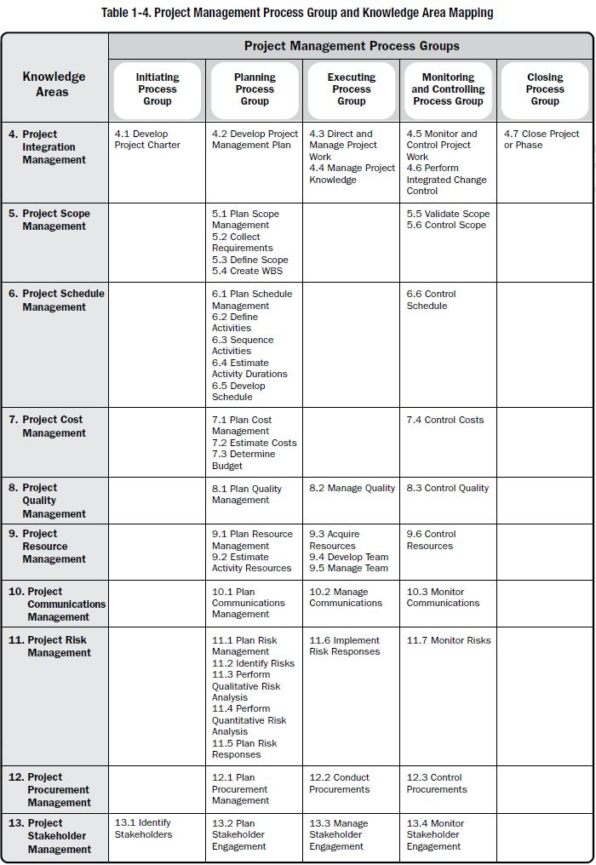
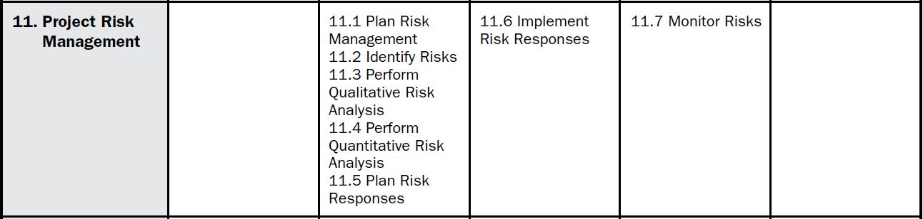
PMBOk
Project Management Institute’s PMBOK Knowledge Areas
Source: PMBOK 6th Edition, 2017

Slide 14
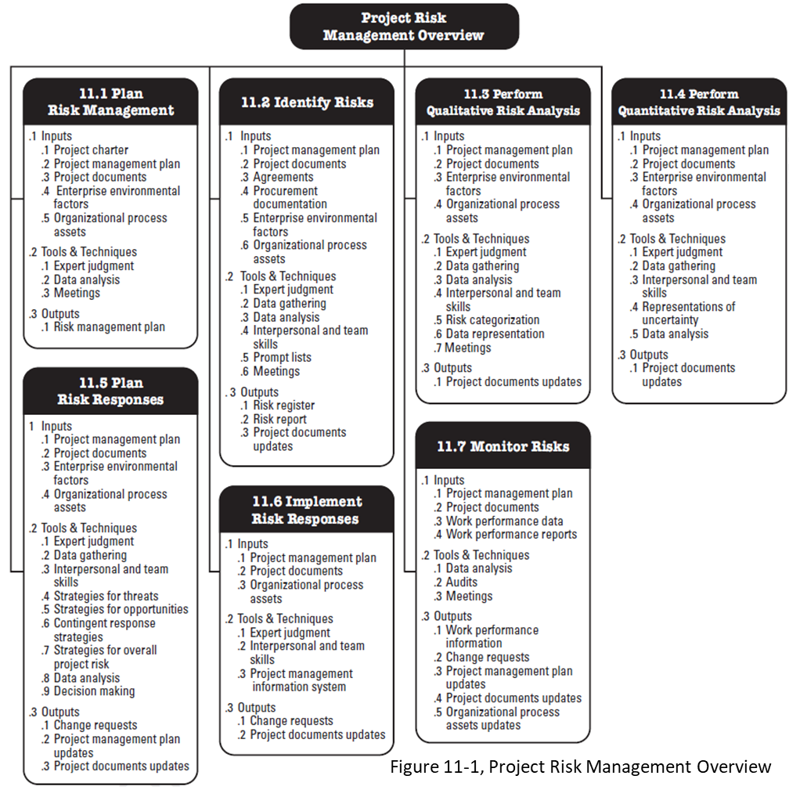
PMBOK
Project Risk Management
Source: PMBOK 6th Edition, 2017

Slide 15
Risk definition
Risk: definition
Probability and magnitude of a loss or some other negative outcome from an undesirable event or activity. –Not the event itself, but the outcome when the event happens –A risk is something we do NOT want
Undesirable event: employees did not complete their work on time –Negative outcomes: the project is delayed, it costs more to recover from delays, and project benefits are lost •Undesirable event: heavy rain –Negative outcome: flooding & erosion •Undesirable activity: corruption –Negative outcomes: The company loses money. People could get hurt. The community loses services.
Examples

Slide 16
Opportunity definition
Probability and magnitude of a benefit or positive outcome from a desirable event happening. •Let’s use the term ‘opportunity’; NOT ‘positive risk’ or ‘impact’ –PMBOK refers to opportunities as ‘positive risks’; risk is negative. –The term ‘Impact’ is sometimes used to describe positive outcomes, which can be misleading; impact is also negative.
Desirable event: employees complete their work ahead of time –Positive outcomes: Project benefits are delivered sooner, and the employees can now work on other important projects •Desirable event: heavy rain –Benefit: agricultural crops are irrigated and will continue to grow •Desirable activity: ethical behaviour –Benefits: The company is trusted to do new projects which make profits and deliver services which the community desires.
Opportunity:
definition
Examples

Slide 17
Risk Management: what are the implications for Projects?
Project Plan and Goals must be realistic, and deliver desired results
•Scope: risks might prevent Scope from completing, and compromise Quality
•Schedule: risks may impose delays in completing scope items, thus increasing costs.
•Cost: risks may further increase costs of completing existing planned scope.
•Benefits: risks may compromise planned benefits.
Projects must avoid surprises and costly changes
•Risk analysis and response must be part of Project Plans.
•Risk & response status must be included in normal, scheduled project reporting.
Company Interest
•When projects don’t deliver according to plans, the company is compromised.
Public and Environmental Interests
•Incompetence, negligence, misconduct, and disregard for the public & environmental interests, must all be avoided

Slide 18
Risk Management: critical issues
•We do not want to be held accountable for events & outcomes outside our control; nor is it appropriate to make decisions which are not ours to make •Organizational management changes over time may also affect accountability for actions; there is no clear decision-maker •Ideally, accountability is shared and controlled by good governance
Risk may be underestimated when level of understanding is low –Education, research and critical thinking is essential
Feasibility: consider the extent to which solutions might work as intended, and whether they are effective at reducing risk •Costs & benefits: consider the accuracy of estimates •Trade-offs: consider risk acceptance, risk tolerance & resultant limitations on what the business can reasonably do •Opportunities: consider the different benefits which might be achieved for different levels of cost and resources
Accountability
Understanding
Action plans

Slide 19


Risk is all around us
Identify three risks within a classroom at a school you’ve attended. If you attending an on-campus Fanshawe classroom, it will be your first choice. Alternatively, use a room in a former place of work, or a local institution where you live.
What internal controls address these risks? How well do they control the risk? Internal controls could include compliance with regulations/standards, procedures/processes and constraints.
An explanation of “internal controls” in risk management can be found at https://www.brighthubpm.com/risk-management/109818-internal-control-and-risk-management/ and first 4 slides at https://www.casrilanka.com/casl/images/stories/EDBA/lecture%2007.pdf
The Risk Management Plan covers “timing” which includes the frequency of performing risk management processes – it can overlap with internal controls.
What did you find?
Notes:
For the 1st link, see Difference, first 2 paragraphs, Common Ground, first 2 paragraphs, and The Process, first 2 paragraphs.

Slide 20

Key Concepts in Project risk
Projects are unique, and frequently complex -- there is risk whenever new activities or approaches are being performed
Changes are frequent in projects, which introduce new risks during the project
Project risks can be positive or negative
Individual vs project level risks in project management:
Individual risk – an uncertainty that could impact some of the project objectives
Project level risk -- where the uncertainty can impact the project as a whole, in its entirety

Slide 21
How much project risk?
Risks will continue to surface during a project and need to be addressed
The project manager and team need to know how much risk is acceptable for the project
Risk tolerance of the project stakeholders can depend on many factors, and can even change during the project
Risk tolerance can change based on the degree to which the project benefits are being achieved
Risk thresholds provide limits for project risk

Slide 22
Trends in project risk management
The risk management approach to projects is expanding to capture different risks that could impact the project
Event risks capture situations where there is an uncertainty over an event such as whether a failure of specialized piece of equipment occurs
Non-event risks
Variability Risk – the variability of some element of a risk. For example, a task where there is never an event where it doesn’t get done, but it could get done very early (which is actually an opportunity) or late (a small threat), or very late (a bigger threat)
Ambiguity Risk – uncertainty due to lack of knowledge or understanding. For example, lack of knowledge of market trends

Slide 23
Known vs unknown risks
DO WE HAVE A GOOD UNDERSTANDING OF THE RISK AND ITS IMPACTS?
“adjective noun”
 | Known understanding of the risk and its impacts | Unknown understanding of the risk and its impacts
Identified/ known risk | Known known Manage the risk | Unknown known Analyze to better understand the risk and plan for risk
Unidentified/unknown risk | Known unknown There is information available about this risk but we haven’t identified it for our project | Unknown unknown Didn’t see it coming. Research and discovery required.
ARE WE AWARE OF THE RISK? HAS IT BEEN IDENTIFIED?
Unknown unknown risks are sometimes called “pure risks”.

Slide 24
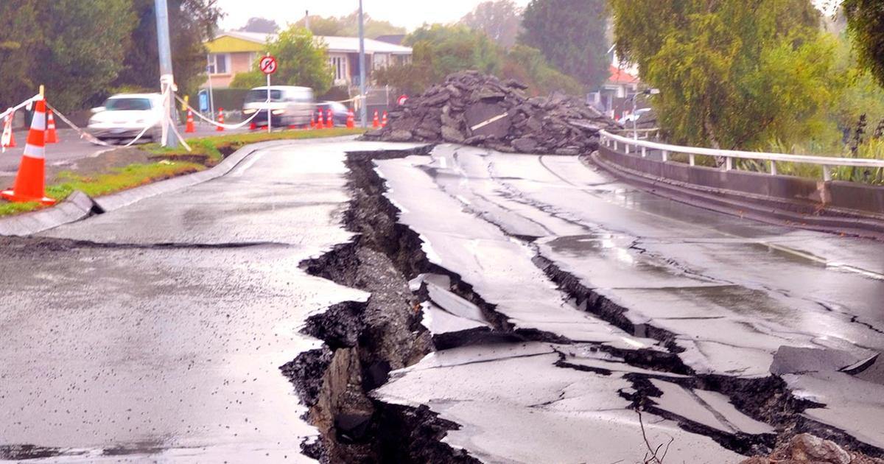



Known vs unknown risks
DO WE HAVE A GOOD UNDERSTANDING OF THE RISK AND ITS IMPACTS/OUTCOMES?
 | Known understanding of the risk and its impacts | Unknown understanding of the risk and its impacts
Identified/known risk | Known known Manage the risk | Unknown known Analyze to better understand the risk and plan for risk
Unidentified/ unknown risk | Known unknown There is information available about this (type of) risk but we haven’t identified it for our project | Unknown unknown Didn’t see it coming. Research and discovery required.
ARE WE AWARE OF THE RISK? HAS IT BEEN IDENTIFIED?
Notes:
Crown – The people preparing for the queen’s funeral etc knew (a KNOWN risk) that she would die someday. The UNKNOWNS were how, when, where, etc.
Earthquake – We KNOW there will be a major earthquake on Canada’s west coast some day. The UNKNOWNS are when, magnitude, impact, etc.
Cancelled flight – We’re planning a event where success depends on certain important people being there. We didn’t identify the risk (therefore, UNKNOWN risk for the project) of cancelled flights but we do know the impact of that happening.

Slide 25

Emergent risks and project resilience
There are actually two types of unknown unknown risks. The first is “unknown-but-knowable unknowns” and the second “unknown-and-unknowable unknowns”
The former we could uncover through research and a discovery process but the latter we never discover until they occur, and the latter is more of a true emergent risk
But we can take steps to make our project more resilient to “unknown-and-unknowable unknowns”, for example:
We can use flexible project processes that can better deal with emergent risks
We can identify emergent risks sooner if we actively look for them

Slide 26
Tailoring and project risk management
There are multiple factors that affect how we choose to execute project risk management:
The complexity of the project
The strategic importance of the project
The organizations tolerance on the particular project
The size of the budget, effort, and resources used on the project
Is the project an agile or predictive approach
For a small, low budget project with a low importance score, our risk plan could be written on one page or less.

Slide 27
Homework and evaluations
M1 and upcoming M2 readings per Course at a Glance summary (i.e., readings from Kerzner, PMBOK, Newton)
Assignments and quizzes, check the Course at a Glance and FOL/Content/Course Assignments & FOL/Evaluations/Quizzes

